Slide 1

Static & Dynamic 1
Lecture 1

Slide 2
Syllabus
Static:
  Application on space vectors
  Resultant of a set of forces
  Moments
  Equivalent couple of moment
  Equation of equilibrium for rigid body
  Types of support
  Trusses
Dynamic:
  Kinematics of particle
    Rectilinear motion
    Curvilinear motion
      Cartesian coordinates
      Projectile motion
      Natural coordinates
      Polar coordinates
      Relative motion
  Kinematics of particle
    Acceleration force method
References:
Engineering Mechanics: Statics & Dynamics by Russell Hibbeler, Pearson; 15thEdition, 2021.

Slide 3

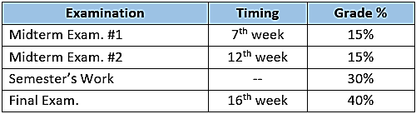
Marks Distribution

Slide 4
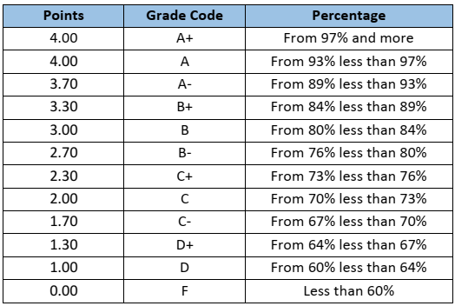
GRADES

Slide 5
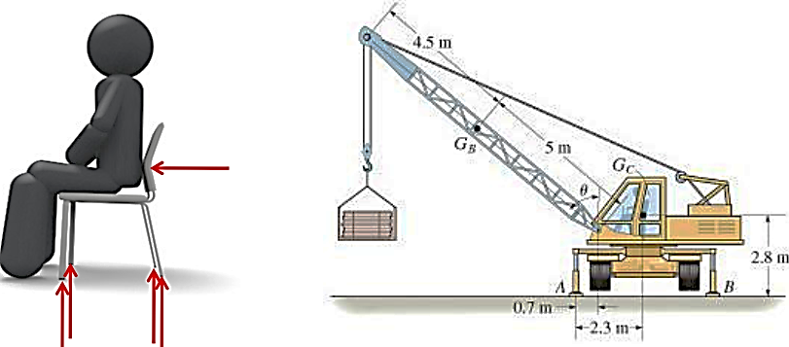
Engineering Mechanics: static
deals with equilibrium of bodies under action of forces

Slide 6
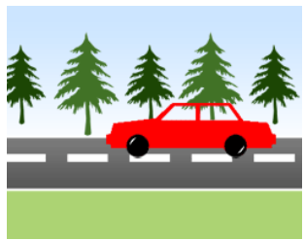
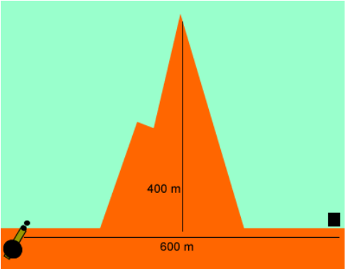
Engineering Mechanics: Dynamic
deals with motion of bodies (accelerated motion)

Slide 7
Fundamental Concepts
Length (Space): needed to locate position of a point in space, & describe size of the physical system Distances, Geometric Properties
Time: measure of succession of events basic quantity in Dynamics
Mass: quantity of matter in a body measure of inertia of a body (its resistance to change in velocity)
Force: represents the action of one body on another characterized by its magnitude, direction of its action, and its point of application
Force is a Vector quantity

Slide 8
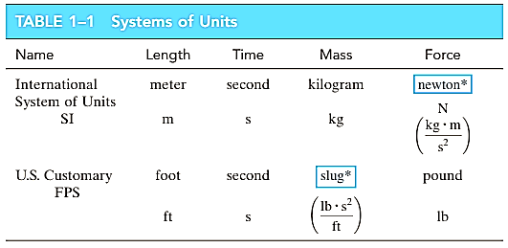
Units

Slide 9
Scalars and Vectors
scalars: only magnitude is associated.
Ex: time, volume, density, energy, mass
Vectors: possess direction as well as magnitude
Ex: displacement, velocity, acceleration, force, moment

Slide 10
Cartesian Vectors IN 2D and 3d, forces in plane, and space
Principle axes and its Unit vectors
Force components on the Principal axes
  Force makes an angle with axes
  Force has a right slop triangle
  Forces act on a line between two points

Slide 11
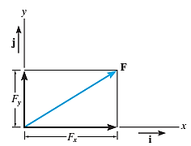
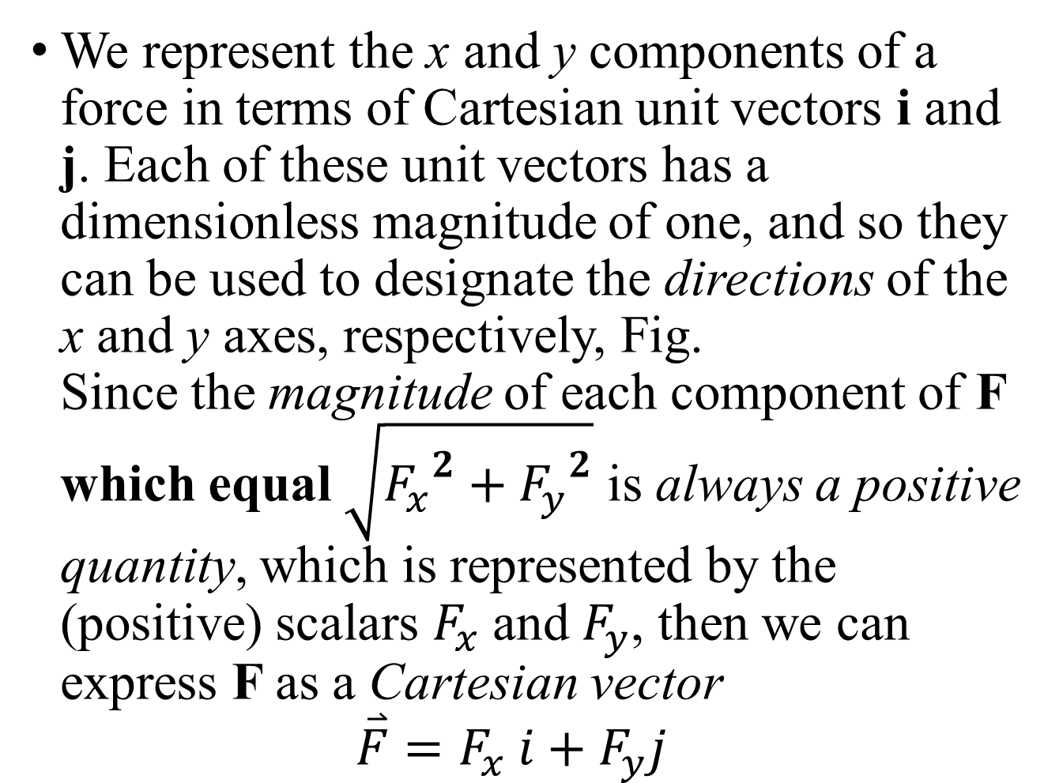


Cartesian Vector Notation.
We represent the x and y components of a force in terms of Cartesian unit vectors i and j. Each of these unit vectors has a dimensionless magnitude of one, and so they can be used to designate the directions of the x and y axes, respectively, Fig.
Since the magnitude of each component of F which equal $\sqrt{{F_{x}}^{2}+{F_{y}}^{2}}$ is always a positive quantity, which is represented by the (positive) scalars $F_{x}$ and $F_{y}$, then we can express F as a Cartesian vector
$\overset{⃑}{F}=F_{x} i+F_{y}j$
$$\hat{j}$$
$$\hat{i}$$

Slide 12
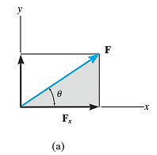
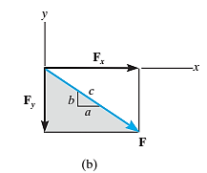

Analyze the forces in 2d
If the forces have a direction $θ$ with any axis x or y as figure a
$\overset{⃑}{F}=F\cos{θ}i+Fsin θj$
if the force has a right slop triangle as figure b
$\overset{⃑}{F}=F\frac{a}{c}i−F\frac{b}{c}j$

Slide 13
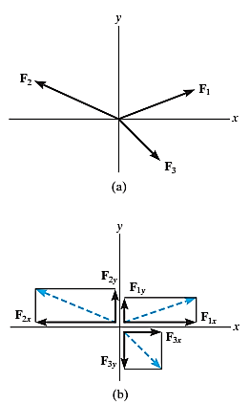


Coplanar Force Resultants.
We can use either of the two methods just described to determine the resultant of several coplanar forces. To do this, each force is first resolved into its x and y components, and then the respective components are added using scalar algebra since they are collinear. The resultant force is then formed by adding the resultant components by adding coefficients of unit vector i and j.

Slide 14
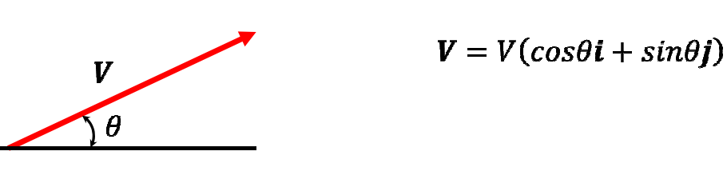
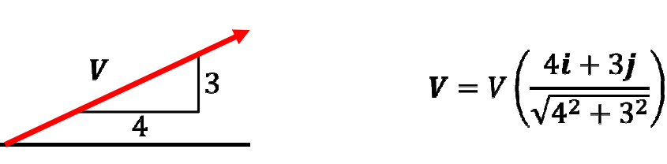
Vectors 2D

Slide 15
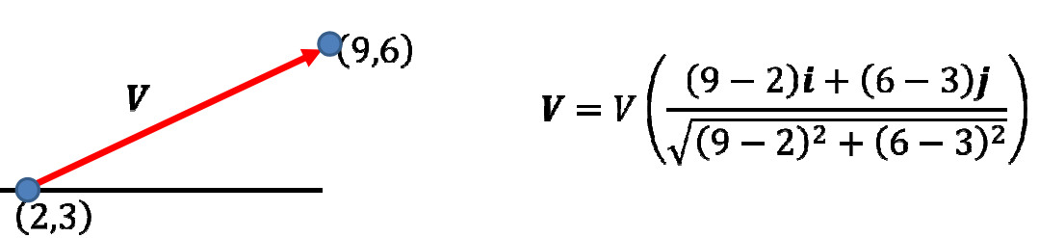

$\overset{⃑}{V}=V \hat{u}$
$\hat{u}=\frac{end point−start point}{magnitude}$

Slide 16
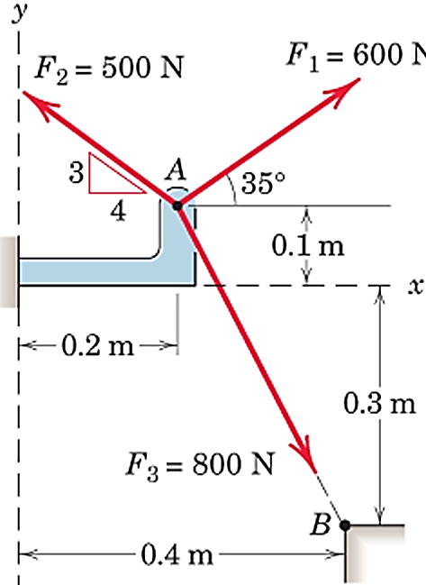

examples
EX1: Write each force in vector form
${\overset{⃑}{F}}_{1}=600 (COS 35 i+\sin{35} j)$ N
${\overset{⃑}{F}}_{2}=500 \left(−\frac{4}{5}i+\frac{3}{5}j\right)$
${\overset{⃑}{F}}_{3}=800 \left(\frac{0.2i−0.4j}{\sqrt{{0.2}^{2}+{0.4}^{2}}}\right)$

Slide 17
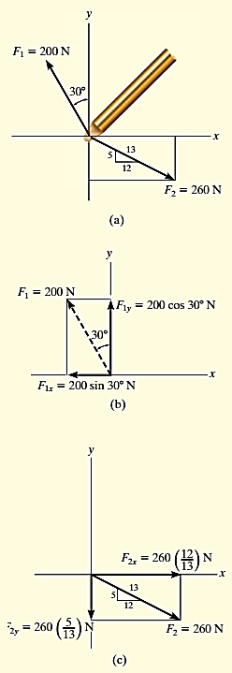
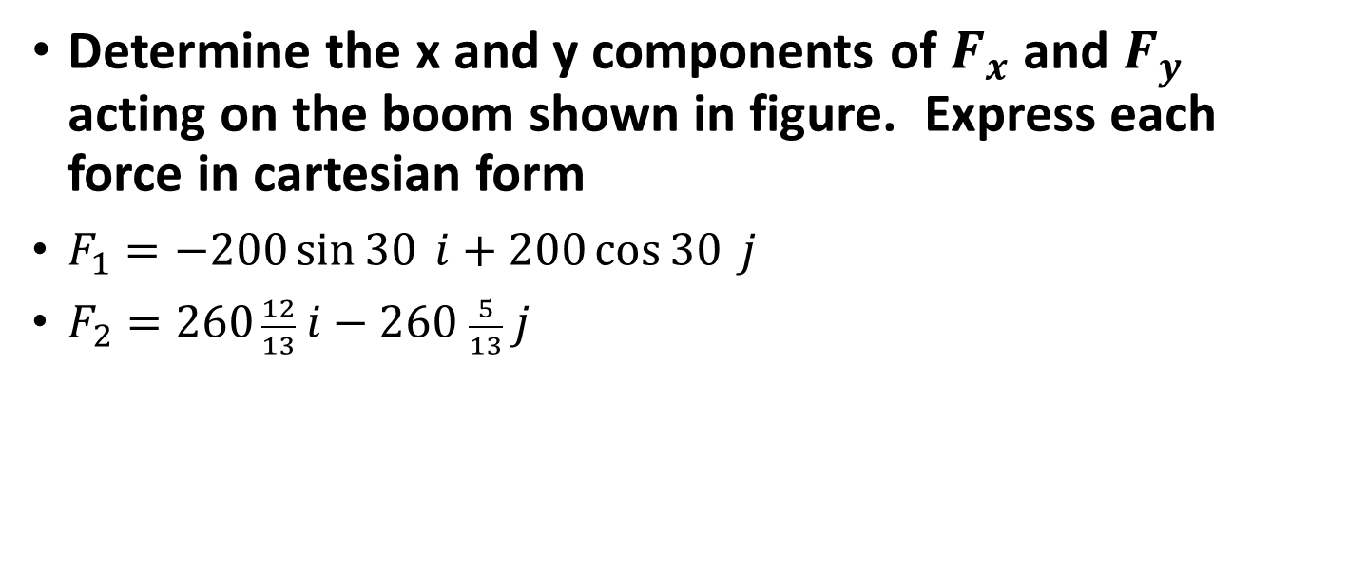
Determine the x and y components of $F_{x}$ and $F_{y}$ acting on the boom shown in figure. Express each force in cartesian form
$F_{1}=−200\sin{30} i+200\cos{30} j$
$F_{2}=260 \frac{12}{13} i−260 \frac{5}{13} j$

Slide 18
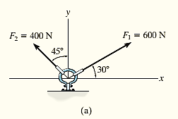
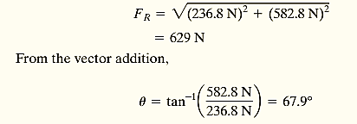
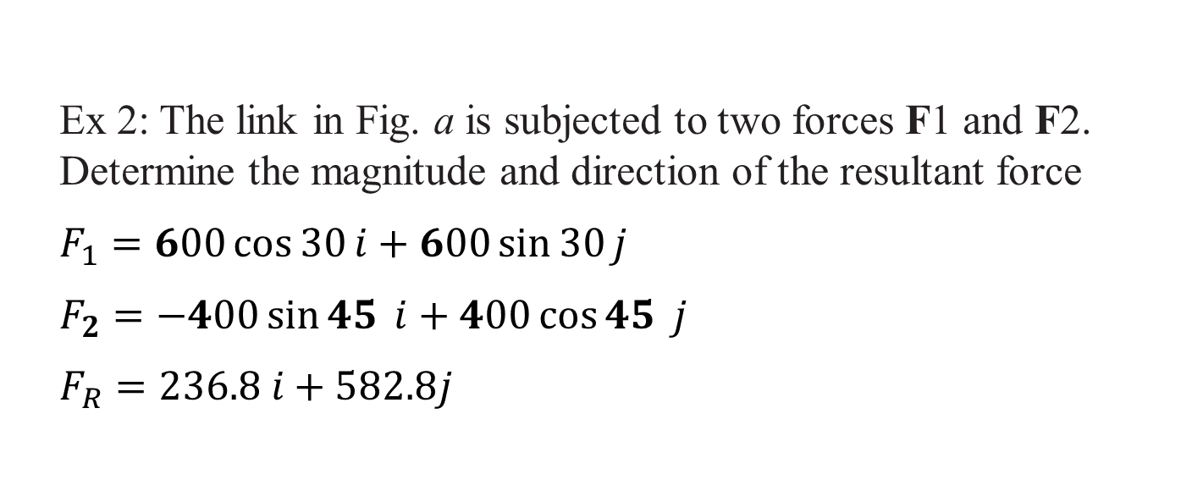
Ex 2: The link in Fig. a is subjected to two forces F1 and F2. Determine the magnitude and direction of the resultant force
$F_{1}=600\cos{30}i+600\sin{30}j$
$F_{2}=−400\sin{45} i+400\cos{45} j$
$F_{R}=236.8 i+582.8j$

Slide 19
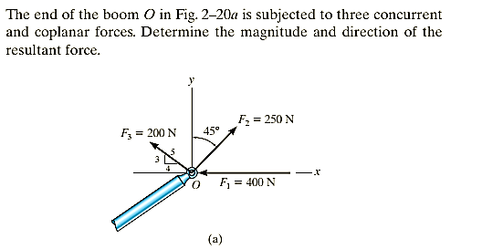

Slide 20
Rectangular Components in Space

Slide 21






$$O=(0,0,0)$$
z
$$\hat{k}$$
$$\hat{j}$$
Coordinate System
$$o$$
y
$$\hat{i}$$
$$x$$

Slide 22

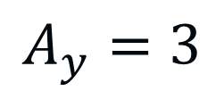

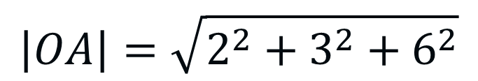

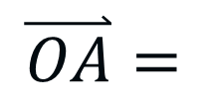







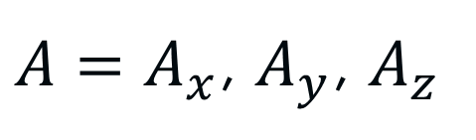
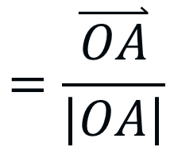





$$O=(0,0,0)$$
z
$$A$$
Cartesian Vector Representation.
$$\hat{k}$$
$$A_{z}$$
$A=A_{x}$, $A_{y}$, $A_{z}$
$$A_{y}$$
$$\hat{j}$$
$$A_{x}$$
y
$$o$$
$$A=(2,3, 6)$$
$$\hat{i}$$
$$A_{x}=2$$
$$A_{y}=3$$
$$\overset{⃑}{OA}=$$
$$A−O$$
$$x$$
$$=(2,3,6)−(0,0,0)$$
$$=2i+3j+6k$$
$$A_{z}=6$$
$$\left|OA\right|=\sqrt{2^{2}+3^{2}+6^{2}}$$
=7
$$=\frac{\overset{⃑}{OA}}{\left|OA\right|}$$
$$=\frac{2i+3j+6k}{\text{7}}$$
$${\hat{u}}_{OA}$$
$${\hat{u}}_{A}=\cos{α}i+ \cos{β}j+\cos{γ}k$$

Slide 23
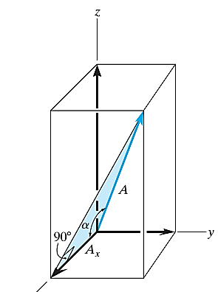
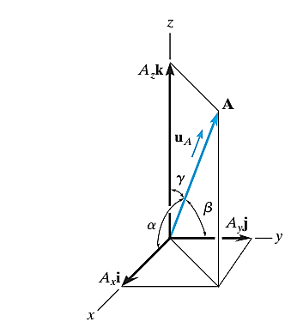

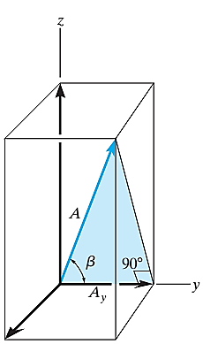
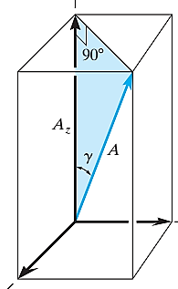



Cosine direction.
$${\hat{u}}_{A}=\cos{α}i+ \cos{β}j+\cos{γ}k$$

Slide 24
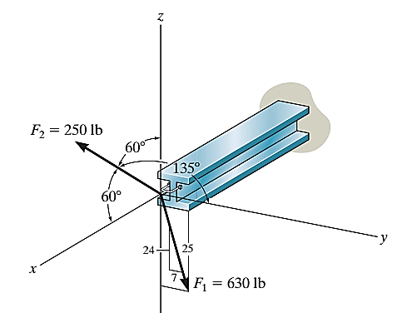

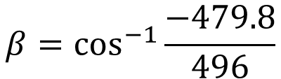
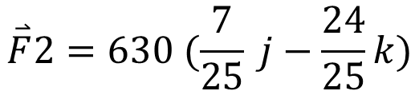
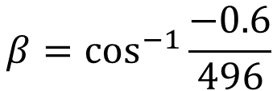
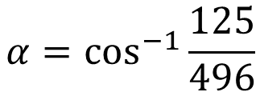
  Express each force acting on the pipe assembly in Cartesian vector form.
  Determine the magnitude and the direction of the
  resultant force acting on the pipe assembly.
$$\overset{⃑}{F}1=250 (\cos{60} i+\cos{135} j+\cos{60}k)$$
$$\overset{⃑}{F}2=630 (\frac{7}{25} j−\frac{24}{25}k)$$
$$\overset{⃑}{F}R=\left\{250\cos{60} i+\left(250\cos{135}+630 ∗\frac{7}{25}\right) j+\left(250\cos{60}−630 ∗\frac{24}{25}\right)k\right\}$$
$$\overset{⃑}{F}R=\left\{125 i−0.6 j−479.8 k\right\}$$
$$\left|\overset{⃑}{F}R\right|=\sqrt{{125}^{2}+{0.6}^{2}+{479.8}^{2}}=496 Ib$$
$$α=\cos^{−1}{\frac{125}{496}}$$
$$β=\cos^{−1}{\frac{−0.6}{496}}$$
$$β=\cos^{−1}{\frac{−479.8}{496}}$$

Slide 25
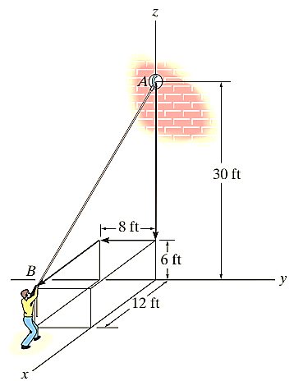






The man shown in Fig. pulls on the cord with a force of 70 lb. Represent this force acting on the support A as a Cartesian vector and determine its direction
$$(0,0,30)$$
$\overset{⃑}{AB}=12 i−8 j−24 k$
$\left|\overset{⃑}{AB}\right|=\sqrt{{12}^{2}+8^{2}+{24}^{2}}=28$
${\hat{u}}_{AB}=\frac{\overset{⃑}{AB}}{\left|\overset{⃑}{AB}\right|}=\frac{12}{28}i−\frac{8}{28}j−\frac{24}{28}k$
${\overset{⃑}{F}}_{70}=70\left(\frac{12}{28}i−\frac{8}{28}j−\frac{24}{28}k \right)$
$= 30 I −20 j− 60 k$
$$(12,−8,6)$$
$$α=\cos^{−1}{\frac{12}{28}}$$
$$β=\cos^{−1}{\frac{−8}{28}}$$
$$γ=\cos^{−1}{\frac{−24}{28}}$$

Slide 26
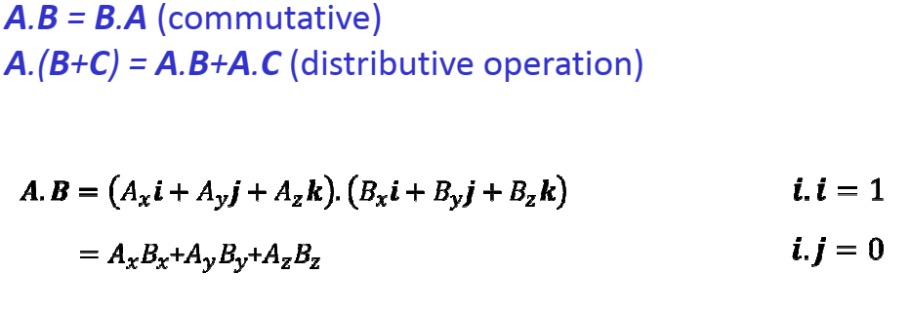
Dot product

Slide 27
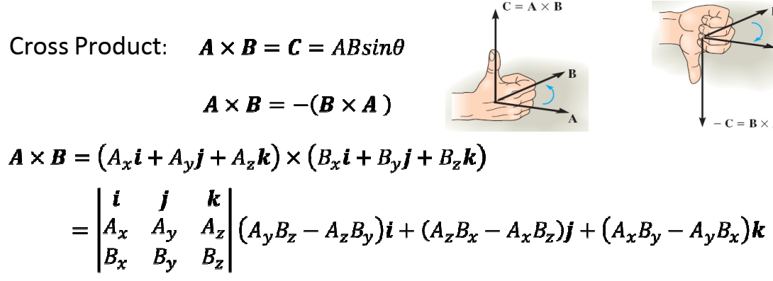
Vector product

Slide 28
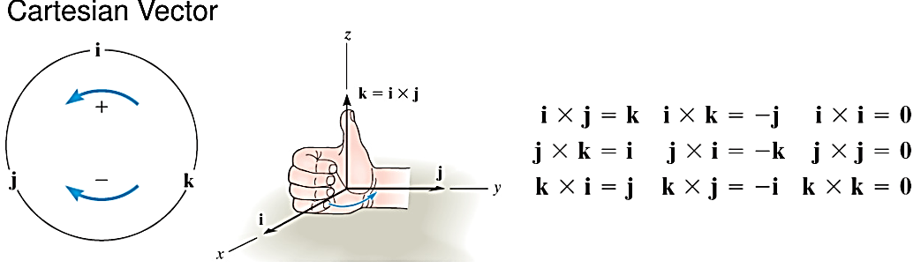

Slide 29
Thanks

